Slide 1

CROP PRODUCTION AND YEILD FORECASTING USING AI TECHNIQUES
Guided by
DR.S.VINSON JOSHUA
ASSOCIATE PROFESSOR
DEPARTMENT OF ECE
Presented by
VTU19353 [M VIGNESHVARAN VEL]
VTU20713 [NAVEEN K M]
VTU20702 [K HRUSHI KESH]

Slide 2
ABSTRACT
Crop yield prediction is a critical aspect of modern agriculture, facilitating efficient resource allocation, risk management, and decision-making for farmers. This project focuses on the devel opment of a predictive model for crop yield using machine learning techniques. The model utilizes historical data on key environmental factors such as rainfall, temperature, and fertilizer usage to fore cast crop yield for future seasons. The dataset, obtained from agricultural records, consists of multiple years’ worth of data collected from various farming regions Before training the model, extensive data preprocessing is performed. This includes normalization of the input features to ensure consistency and scalability across different variables. Additionally, data augmentation techniques are employed to increase the size of the dataset, thereby enhancing the robustness and generalization capability of the model. For the predictive modeling phase, a Gradient Boosting Regressor algorithm is cho sen due to its effectiveness in capturing complex relationships between features and target variables. The algorithm is trained on the preprocessed and augmented dataset, where it learns to predict crop yield based on the provided environmental inputs To evaluate the performance of the model, various metrics such as mean squared error, R-squared, and accuracy are utilized. These metrics provide insights into the model’s predictive accuracy, its ability to capture variance in the target variable, and its overall performance on unseen data Furthermore, an interactive user interface is developed to facilitate easy input of environmental parameters by users and provide real-time predictions of crop yield. Overall, this project aims to contribute to the advancement of precision agriculture by providing a reliable and accessible tool for crop yield prediction, thereby promoting sustainable agricultural practices and food security

Slide 3
OBJECTIVE
The primary objective of this project is to develop a reliable and accurate predictive model for rice yield in TamilNadu, addressing the current limitations of existing models and enhancing the precision of yield forecasts.
Given the scarcity of predictive models specifically tailored to the agricul tural context of TamilNadu, the project aims to fill this gap by leveraging advanced machine learning techniques and local environmental data.
Improving Accuracy and Reliability Enhancing the accuracy and reliability of yield predictions by incorporating local ized data and accounting for the region’s unique climatic conditions, soil characteristics, and farming practices.
By tailoring the model to the specific needs of rice farmers in TamilNadu, the aim is to achieve higher prediction accuracy compared to existing models.Optimizing Resource Allocation Pro viding farmers with valuable insights and actionable information to optimize resource allocation and management strategies.

Slide 4
INTRODUCTION
Rice cultivation holds significant importance in the agricultural landscape of Tamil Nadu, a state located in the southern part of India. Tamil Nadu is renowned for its diverse agricultural practices, with rice being one of the primary staple crops cultivated across the region. The state’s favorable climatic conditions, including ample rainfall and fertile soil, make it conducive to rice cul tivation throughout the year.Rice plays a crucial role in the socio-economic fabric of Tamil Nadu, serving as a staple food for its large population and a source of livelihood for millions of farmers. The cultivation of rice is deeply ingrained in the cultural heritage of the state, with traditional farming practices passed down through generations.Despite its significance, rice cultivation in Tamil Nadu faces numerous challenges, ranging from fluctuating weather patterns to limited access to resources and in frastructure. Farmers often struggle to optimize crop production and resource management, leading to variability in yields and economic uncertainties.In recent years, advancements in agricultural technol ogy and the adoption of modern farming techniques have aimed to address these challenges. However, accurate prediction of rice yield remains a key concern for farmers and policymakers alike. Inaccu rate yield forecasts can lead to suboptimal decision-making regarding planting schedules, irrigation management, and fertilizer application, ultimately affecting the overall productivity and profitability of rice cultivation in the region.

Slide 5
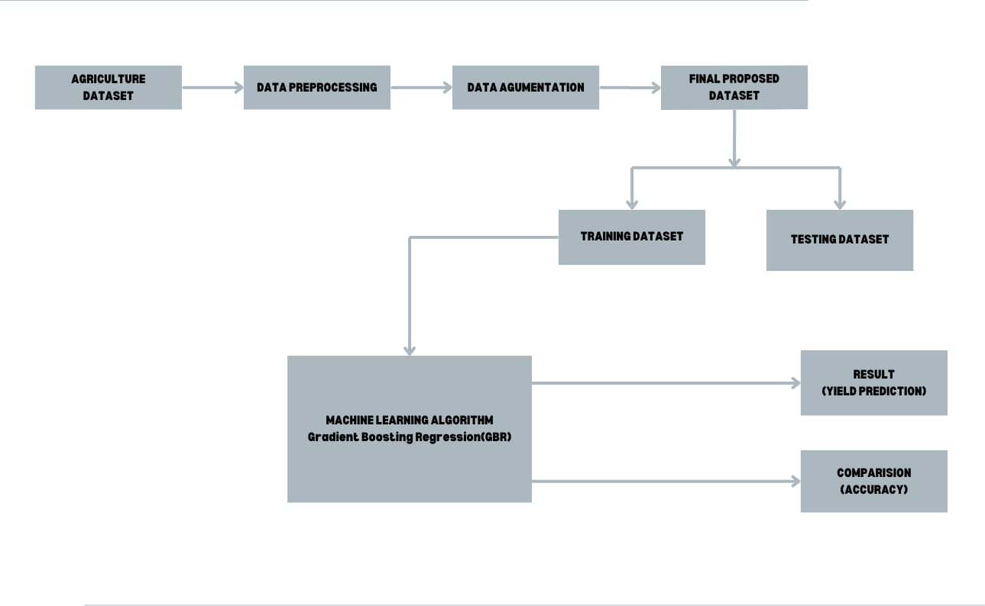
BLOCK DIAGRAM

Slide 6
METHODOLOGY
Data Sources ICRISAT Database: Description of the International Crops Research Institute for the Semi Arid Tropics (ICRISAT) database as the primary source of agricultural data. Data Accessibility: Information on accessing and retrieving rice crop yield data, agronomic variables, and environmental factors from the ICRISAT database.
Data Relevance: Explanation of why the ICRISAT database was chosen and how it provides comprehensive and reliable data for predictive modeling.
Data Variables Key Variables: Identification of the key variables used in the predictive modeling process, including yield records, agronomic practices, soil properties, climate data, etc. Variable Descrip tion: Brief description of each variable, its units of measurement, and its relevance to rice crop yield prediction.
Data Cleaning Missing Values: Discussion on handling missing values in the dataset, including techniques such as imputation or removal based on data availability and quality. Outlier Detection: Explanation of outlier detection methods used to identify and address anomalies or errors in the data. Data Trans formation: Overview of data transformation techniques applied to normalize distributions, reduce skewness, or improve model performance

Slide 7
METHODOLOGY
Model Implementation Algorithm Selection:
Recap of the selected machine learning algorithm for predicting rice crop yield, such as Gradient Boosting Regression (GBR). Software Environment: Description of the programming languages (e.g., Python) and libraries (e.g., scikit-learn) used for model implementation.
Code Structure:
Overview of the code structure, including data preprocessing, model training, and evaluation steps.
Integration with Pipeline:
Consideration of integrating the GBR model into an end-to-end pipeline for seamless data processing and prediction.
Performance Monitoring:
Discussion on monitoring the performance of the GBR model over time to detect drifts or degradation in prediction accuracy. Feedback Loop: Implementation of a feedback loop to incorporate new data and continuously update the GBR model for improved performance. Version Control: Consideration of version control techniques for tracking changes to the GBR model and ensuring reproducibility. Maintenance Schedule: Establishment of a maintenance schedule for regular updates, bug fixes, and enhancements to the GBR model.

Slide 8
LITERATURE SURVEY
OVERVIEW :
The literature survey explores the landscape of rice cultivation, yield prediction models, and agricultural practices in Tamil Nadu, with a focus on identifying key research findings, methodologies, and advancements in the field. The survey is structured into several sections, each addressing specific aspects of rice yield prediction and agricultural sustainability
Review of Studies on Rice Yield Prediction Models :
Rice yield prediction models play a pivotal role in informing agricultural decision-making and resource allocation strategies for farmers in Tamil Nadu. In recent years, there has been growing interest in the application of machine learning techniques, particularly gradient boosting regression (GBR), for rice yield prediction in the region.GBR Model in Rice Yield Prediction: Recent research efforts have explored the effectiveness of gradient boosting regression (GBR) models in predicting rice yields in Tamil Nadu. Unlike traditional statistical approaches, GBR models leverage ensem ble learning techniques to combine the predictive power of multiple weak learners, such as decision trees, and iteratively improve model performance through boosting.

Slide 9
LITERATURE SURVEY
Factors Influencing Rice Yields :
Rice yield in Tamil Nadu is influenced by a multitude of factors, ranging from environmen tal conditions and agronomic practices to socio-economic dynamics. Understanding these factors is essential for developing accurate predictive models and implementing effective agricultural strategies. This section explores the key determinants of rice yield in the region.
Technological Innovations in Rice Farming :
Technological innovations have revolutionized rice farming practices in Tamil Nadu, offering new tools and strategies to enhance productivity, efficiency, and sustainability. This section examines the role of technology in shaping modern rice cultivation methods and improving yield outcomes. Precision Agriculture Techniques: Remote Sensing and GIS: Discusses the use of satellite imagery, drones, and geographic information systems (GIS) for monitoring crop health, detecting stress factors, and optimizing field management practices. Explores applications such as crop mapping, yield esti mation, and resource allocation. Variable Rate Technology (VRT): Examines the adoption of VRT for precise nutrient and water management in rice fields. Discusses the benefits of site-specific application of inputs based on soil variability and crop requirements.

Slide 10
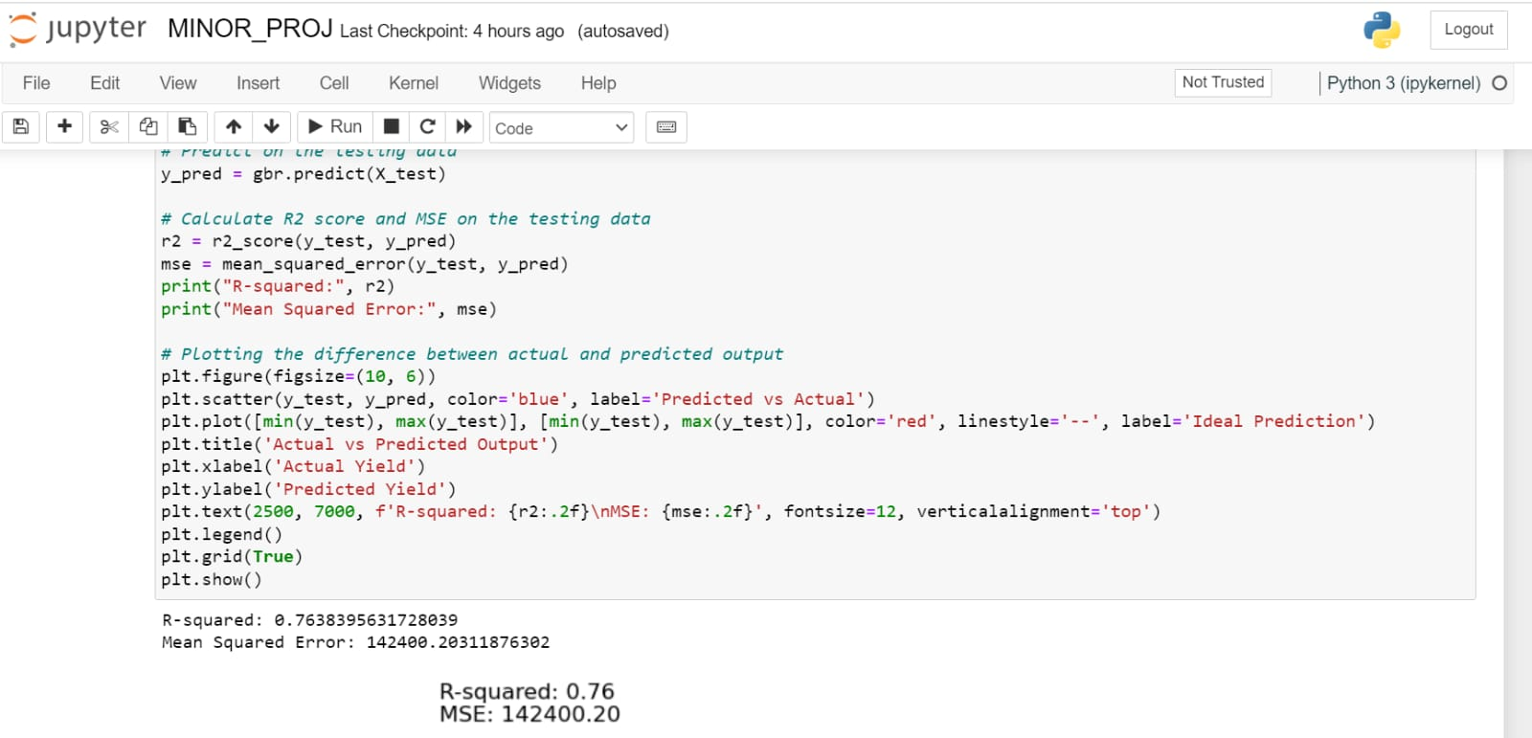
RESULTS

Slide 11
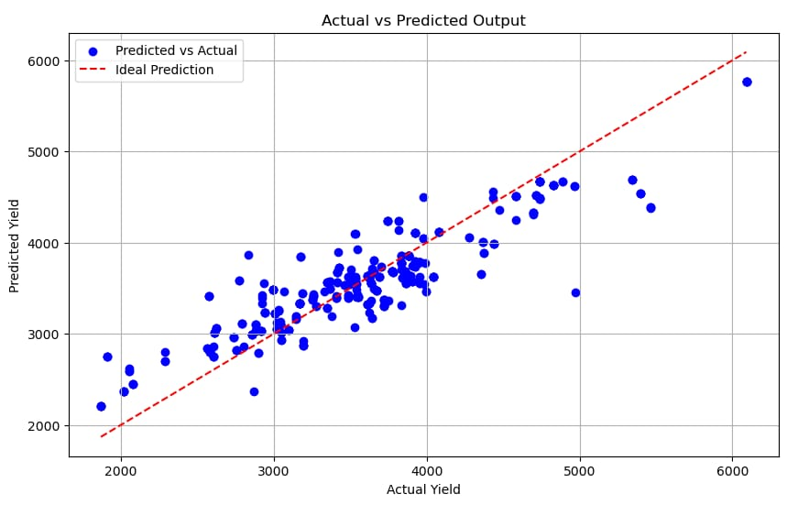
RESULTS

Slide 12
TIMELINE PLAN
S.No | Project Activity | Description | Date of completion (or) Week number
1. | Literature Survey | Analyze critically and concisely earlier research and literature related to crop and yield prediction system and utilize them | Week 1
2. | Design | To implement machine learning for crop yield prediction, a large dataset of crop yield data is required. This data should include information about the crop | Week 2
3. | Coding/Implementation | Software implementation is done using ML algorithms | Week 3 & 4
4. | Analysis | Evaluate the performance of the algorithms Detection System in terms of accuracy. | Week 5 & 6
5. | Results and discussion | Prediction of crop yield is carried out using statistical and machine learning algorithms | Week 7 & 8
6. | Documentation | Recording the key project details and producing the documents that are required to implement it successfully.. | Week 9 & 10
7. | Paper publication | Identify a journal with aims & scope close to your research work | Week 11 & 12

Slide 13

HARDWARE / SOFTWARE USED
JUPITER NOTEBOOK
PYTHON PROGRAMMING
ML MODELS

Slide 14
REFERENCES
[1] Exploration of Machine Learning Approaches for Paddy Yield Prediction in Eastern Part of Tamil nadu Vinson Joshua 1,*, Selwin Mich Priyadharson 1 and Raju Kannadasan.
[2] Feng, P.; Wang, B.; Liu, D.L.; Waters, C.; Yu, Q. Incorporating machine learning with biophys ical model can improve the evaluation of climate extremes impacts on wheat yield in south-eastern Australia. Agric. For. Meteorol. 2019, 275, 100–11
[3] Rashid, M.; Bari, B.S.; Yusup, Y.; Kamaruddin, M.A.; Khan, N. A Comprehensive Review of Crop Yield Prediction Using Machine Learning Approaches with Special Emphasis on Palm Oil Yield Prediction. IEEE Access 2021, 9, 63406–63439
[4] Khosla, E.; Dharavath, R.; Priya, R. Crop yield prediction using aggregated rainfall-based mod ular artificial neural networks and Support vector regression. Environ. Dev. Sustain. 2019, 22, 5687–5708.
[5] Edreira, J. I. R., and M. E. Otegui. 2012. Heat stress in temperate and tropical maize hybrids: Differences in crop growth, biomass partitioning and reserves use. Field Crops Research 130:87–98. doi:10.1016/j.fcr.2012.02.009.

Slide 15
THANK YOU

